Slide 1
PROPERIOCEPTORS
By
Dr. Mahadevi A.L
Dept of Physiology
SKHMC

Slide 2
PROPERIOCEPTORS
Proprioceptors are sensory receptors located in the subcutaneous tissues. They are capable of detecting motion (or movement) and position of the body through a stimulus produced within the body.
They relay information to the brain when a body part is moving or its position relative to the rest of the body.
These receptors are also called kinesthetic receptors.
It is sometimes described as the "sixth sense".

Slide 3
It is situated in labyrinth, muscles, tendon, joints, ligaments and fascia.
Different Proprioceptors:
1. muscle spindle
2.golgi tendon organ
3.pacinian corpuscle
4.free nerve ending
5.properioceptors in labyrinth

Slide 5
Muscle spindle
Spindle shaped Proprioceptors situated in the skeletal muscle.
It is formed by modified skeletal muscle fibres called intrafusal muscle fibres.
Structure:
It has a central bulged portion and two tapering ends.
Each muscle spindle is formed by 5-12 intrafusal muscle fibres
All these fibres are enclosed by a capsule ,which is formed by connective tissue

Slide 6
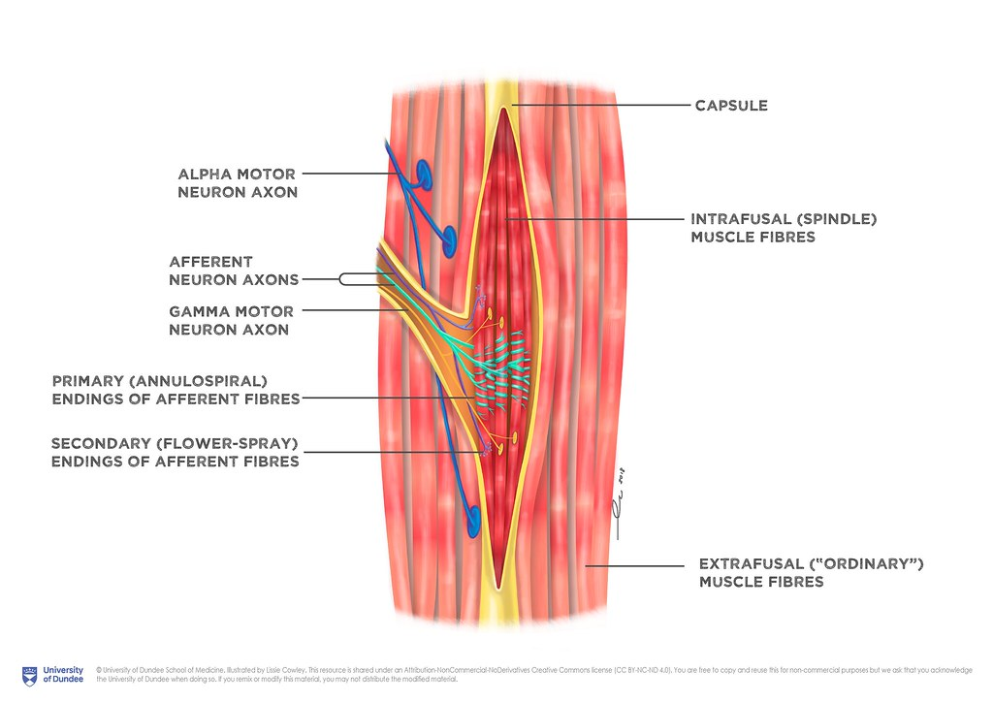

Slide 7
Intrafusal fibres are attached to the capsule on either end.
The capsule is attached to either side of extrafusal fibres or tendons of the muscle
Thus intrafusal fibres are placed parallel to the extrafusal fibres
Intrafusal fibres are thin and striated
Central portion of intrafusal fibres does not contract because it has only few or no actin and myosin filaments. So this portion acts only as a receptor.
Only the end portion of intrafusal fibres can contract .
The discharge from gamma motor neurons causes the contraction of intrafusal fibres.

Slide 10
Nerve supply
Muscle spindle is innervated by both sensory and motor nerves.
It is the only receptor in the body which has both sensory and motor nerve supply.
Sensory nerve supply
Each muscle spindle receives 2 two types of sensory nerve fibre
1. primary sensory nerve fibre
2.secondary sensory nerve fibre

Slide 11
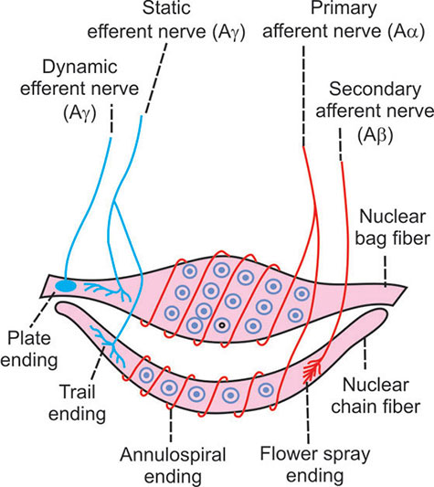

Slide 12
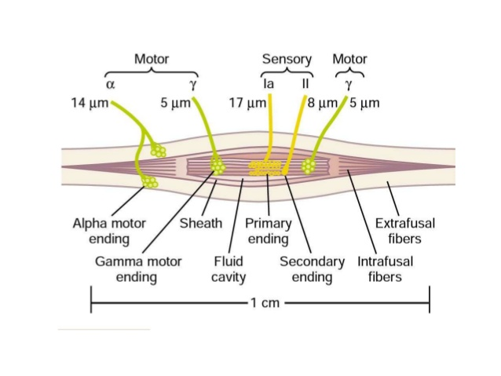

Slide 14
Primary sensory nerve fibre
It belongs to type I Alpha(A alppha) nerve fibre
Each sensory (afferent) nerve fibre has 2 branches
One of the branches supplies the central portion of nuclear bag fibre
The other branch ends in central portion of nuclear chain fibre .
These branches ends in the form of rings around central portion of nuclear bag and nuclear chain fibres
Therefore these nerve endings are called annulo spiral endings.

Slide 15
Secondary sensory nerve fibre
It is a type II (A beta) nerve fibre
It innervates only the nuclear chain fibre and ends near the end portion of nuclear chain fibre like the petals of the flower
So this nerve ending is called flower spray ending.

Slide 16
Motor nerve supply
Motor (efferent ) nerve fibre supplying the muscle spindle belongs to gamma motor neuron AY type.
Motor nerve supply to nuclear bag fibre
Gamma motor nerve fibre supplying the nuclear bag fibre ends as motor end plate. These nerve ending is called plate ending
Functionally it is known as dynamic gamma efferent (motor) nerve fibre.

Slide 17
Motor nerve supply to nuclear chain fibre
Gamma motor nerve fibre supplying the nuclear chain fibre divides into many branches, which form a network called trail ending.
Functionally it is known as static gamma efferent (motor) nerve fibre.
Sometimes it gives a branch to nuclear bag fibre also.

Slide 18
Function of muscle spindle
It gives response to change in the length of the muscle.
It detects how much the muscle is being stretched and sends this information to CNS via sensory n fibres.
The information is processed in CNS to determine the position of different parts of the body.
By detecting the change in length of muscle ,the spindle plays important role in preventing the overstretching of the muscles.
It has two functions
Forms the receptor organ for stretch reflex
Plays an important role in maintaining muscle tone

Slide 19
Role of muscle spindle in stretch reflex
Stretch reflex
It is the reflex contraction of muscle when it is stretched
It is also called myotatic reflex
It Is a monosynaptic reflex and the quickest of all the reflex
Extensor muscles, particularly the antigravity muscles exhibit a severe and prolonged contraction during stretch reflex
It plays an important role in maintaining posture.

Slide 20
Muscle spindle as the receptor organ for stretch reflex
Stimulation of muscle spindle elicits the stretch reflex
Intrafusal muscle fibres are situated parallel to the extrafusal muscle fibres and are attached to the tendon of the muscle by means of capsule .
So stretching of the muscle causes stretching of the muscle spindle also.
This stimulates the muscle spindle and it discharges the sensory impulses.
These impulses are transmitted through the primary and secondary sensory nerve fibres to the alpha motor neurons in spinal cord.
Alpha motor neurons in turn send motor impulse to muscles through their fibres and cause contraction of extrafusal fibres.

Slide 23
Response of muscle spindle to stretch
When the muscle is stretched, primary sensory nerve fibres from muscle spindle discharge impulses.
This response is of two types
i. dynamic response
ii. static response
Dynamic response
It is the response in which the primary sensory nerve fibre discharge rapidly.
When there is a change in length of the muscle by stretching, primary sensory nerve fibre from nuclear bag fibre start discharging impulses very rapidly.
But the discharge becomes less or nil during continuous stretching of the muscle.
Discharge of impulses start only if there is change in degree of stretching of the muscle.
Thus the response depends upon the rate of change in length of muscle

Slide 24
Static response
It is the response in which impulses are discharged rapidly and continuously throughout the period of muscle stretch by primary sensory n fibres of the nuclear chain fibres
Thus the muscle spindle gives response to change in length of the muscle as well as the rate of change in length.

Slide 25
Role of muscle spindle in maintenance of muscle tone
The state of continuous and partial contraction of muscle is called muscle tone.
It is due to continuous discharge of impulses from gamma motor neurons.
Gamma moor neurons innervate the intrafusal fibres.
Motor impulses from gamma motor neurons stimulate the intrafusal fibres of muscle spindle ,which in turn sends sensory impulses back to spinal cord
Now the alpha motor neurons in spinal cord are activated resulting in contraction of extrafusal fibres of muscle
when the frequency of discharge from gamma motor neurons increases ,activity of muscle spindle increases and the muscle tone also increases

Slide 26
Golgi tendon organ(GTO)
Structure:
Situated in the tendon of the skeletal muscles near the attachment of extrafusal fibres
It is placed in series between the muscle fibres and the tendon.
It is formed by a group of nerve endings covered by a connective tissue capsule

Slide 27
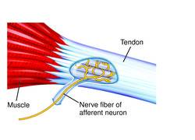

Slide 28
Nerve supply
Sensory nerve fibres supplying the GTO belongs to Ib type
These nerve fibres ramifies into many branches
Each branch ends in the form of a knob.
Function of Golgi tendon organ
It gives response to the change in the force or tension developed in the skeletal muscles during contraction.
It is also the receptor for inverse stretch reflex and lengthening reaction and thereby prevents damage of muscle due to overstretching,

Slide 29
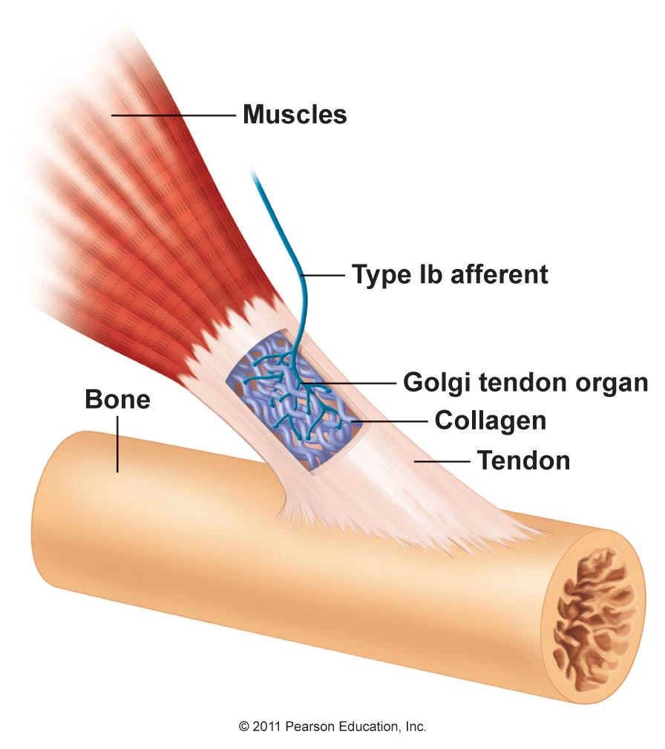

Slide 30
Role of GTO in forceful contraction
During powerful contraction tension in the muscles increases and stimulates Golgi tendon organ , which discharges the sensory impulses
Impulses are transmitted by Ib sensory nerve fibre to an inhibitory interneuron in the spinal cord.
Interneuron in turn cause development of inhibitory post synaptic potential in motor neurons which supply the muscle
Now the contraction of muscle is inhibited

Slide 31
Role of GTO in inverse stretch reflex
Inverse stretch reflex
It is the sudden decrease in resistance due to relaxation when a muscle is stretched excessively
Also called inverse myotatic reflex and it is a polysynaptic reflex
It is actually the inhibition of contraction due to excessive stretching
So it is also called the autogenic inhibition

Slide 32
Mechanism of inverse stretch reflex
Excessive stretch of the muscle leads to activation of GTO, which send afferent impulses which cause
1.stimulation of inhibitory internuncial neuron, which in turn inhibits alpha motor neuron of the stretched muscle resulting in relaxation
2. stimulation of excitatory internuncial neuron, which in turn activates alpha motor neuron of the antagonistic muscle resulting in contraction of antagonistic muscle and relaxation of stretched muscle.

Slide 33
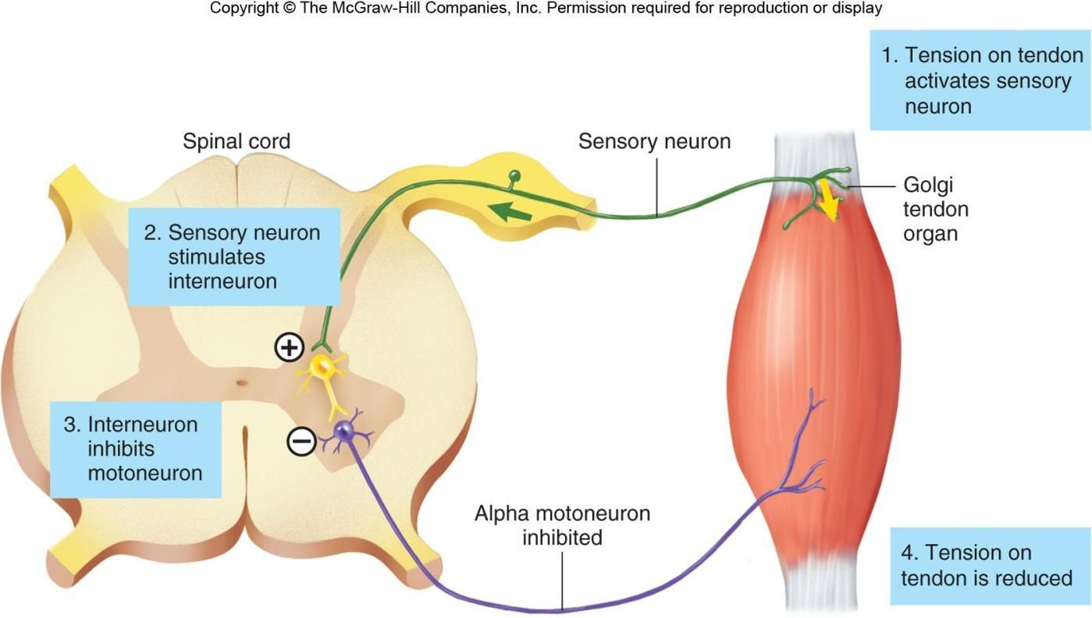

Slide 34
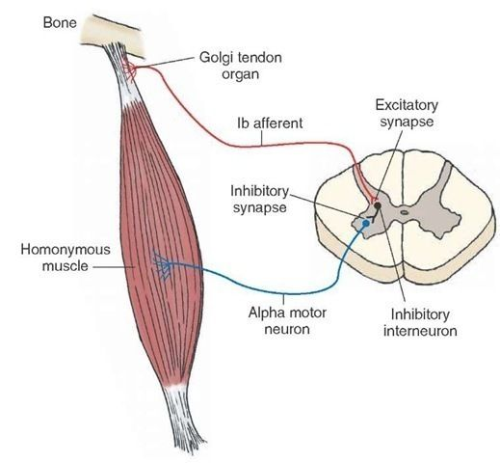

Slide 35
Role of GTO in lengthening reaction
When tension increases during muscular contraction caused by stretch reflex, the GTO is activated.
It causes development of spinal reaction ,which is called the lengthening reaction
It can be demonstrated in a decerebrate preparation
In decerebrate rigidity ,the extension of limbs is due to spastic contraction of extensor muscles
It is because of increased discharge from gamma motor neurons, which facilitates the stretch reflex.
lengthening reaction is due to the activation of GTO.
The sudden flexion of arm is called Phillipson reflex or clasp knife reflex.

Slide 36
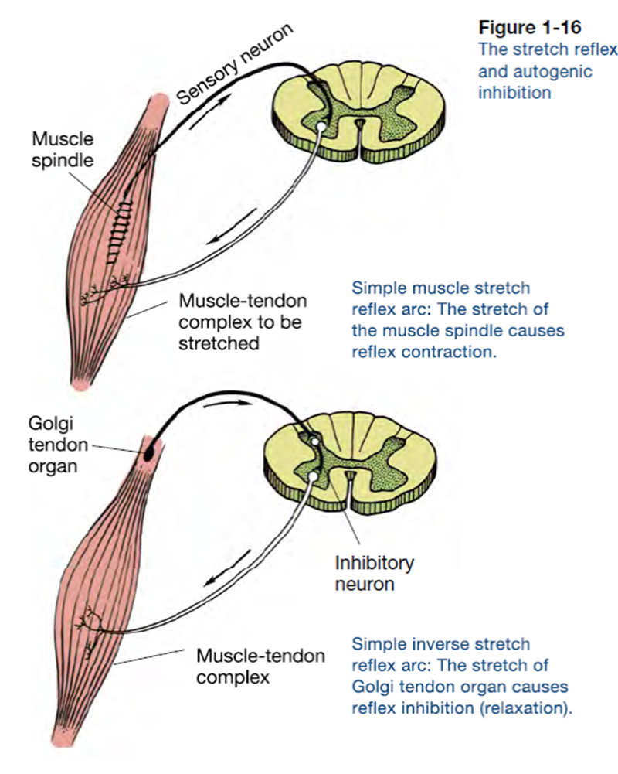

Slide 37
Pacinian corpuscles
It is a mechanoreceptor that senses pressure and vibration.
situated in the deeper layers of the skin, tissues surrounding the joints such as fascia over the muscle, tendons and joint capsule
Pacinian corpuscles situated in these tissues are responsible for determining the position of joints.
It is a rapidly adapting receptor it is very sensitive to quick changes in the position of joints.
So it is believed to send information about joint movement to CNS.

Slide 38
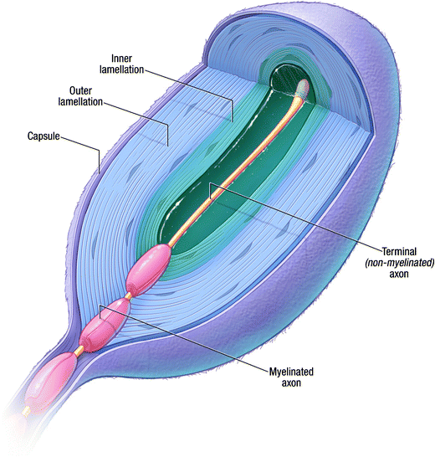

Slide 39
Free nerve ending
It is the receptor for pain sensation situated in skin, muscles, tendon, fascia and joints
As it is a slow adapting receptor(tonic receptor)
It is maximally stimulated at specific joint positions
So it is believed to send information about joint position to CNS.

